Slide 1
Controlling: Cost element and Cost center accounting
Notes:
This Inhouse course was developed to meet the needs of SAP R/3 Consultants working at Capgemini. This course is designed to present a high level view of Controlling and to provide the Consultants with basic information about how to use this Functionality.
More indepth courses have been developed to train Consultants in specific areas discussed during this course.
Your comments at the conclusion of this training session are appreciated and will help us better tailor future courses to meet your training needs.

Slide 2
Cost Element Accounting
Cost Element Accounting component provides information which includes the costs and revenue for an organization. These postings are automatically updated from FI (Financial Accounting) to CO (Controlling). The cost elements are the basis for cost accounting and enable the user to display costs for each of the accounts that have been assigned to the cost element.
There are two types of Cost elements
Primary cost elements
Secondary cost elements

Slide 3
Primary cost elements
Primary Cost or Revenue Element: A primary cost or revenue element is a cost or revenue relevant item in the chart of accounts, for which a corresponding general ledger (G/L) account exists in Financial Accounting (FI). You can only create the cost or revenue element if you have first defined it as a G/L account in the chart of accounts and created it as an account in Financial Accounting. The SAP System checks whether a corresponding account exists in Financial Accounting.
Examples of primary cost elements include:
Material costs
Personnel costs
Energy costs

Slide 4
Secondary Cost Elements:
Secondary cost elements can only be created and administrated in cost accounting (CO). They portray internal value flows, such as those found in internal activity allocation, overhead calculations and
settlement transactions.
When you create a secondary cost element, the SAP System checks whether a corresponding account already exists in Financial Accounting. If one exists, you can not create the secondary cost element in cost accounting.
Examples of secondary cost elements include:
Assessment cost elements
Cost elements for Internal Activity Allocation
Cost elements for Order Settlement

Slide 5
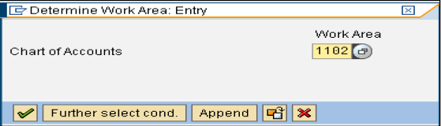
Creation of primary and secondary cost elements (Automatic Creation)
Step 1:Make Default Settings
Path: SPRO->Controlling->Cost Element Accounting->Master Data->Cost Elements->Automatic Creation of Primary and Secondary Cost Elements->Make Default Settings.
Enter your chart of account and press enter key or click on continue button.

Slide 6

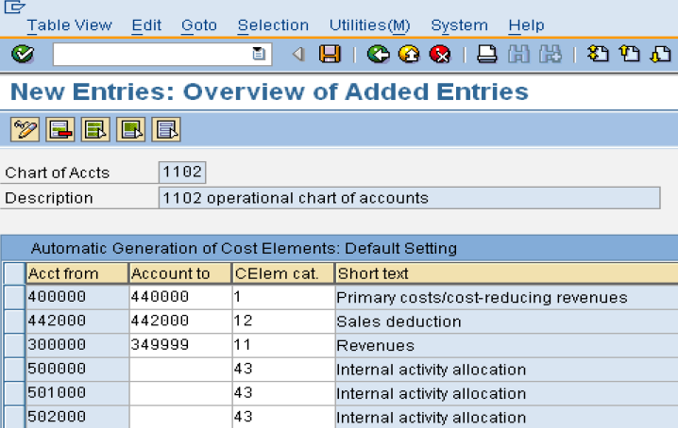
Creation of primary and secondary cost elements (Automatic Creation)
In the next screen click on button
Click on save button

Slide 7
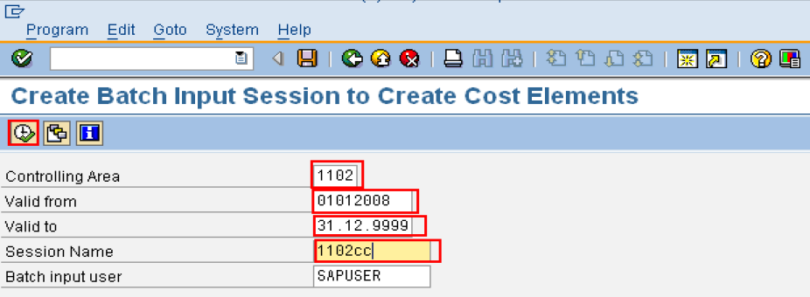
Creation of primary and secondary cost elements (Automatic Creation)
Step 2: Create Batch Input Session
Path: SPRO->Controlling->Cost Element Accounting->Master Data->Cost Elements->Automatic Creation of Primary and Secondary Cost Elements-> Create Batch Input Session.
In the below window enter all parameters and click on execute button

Slide 8
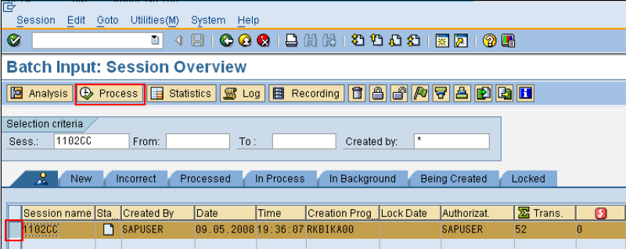
Creation of primary and secondary cost elements (Automatic Creation)
Step 3: Execute Batch Input Session
Path: SPRO->Controlling->Cost Element Accounting->Master Data->Cost Elements->Automatic Creation of Primary and Secondary Cost Elements-> Execute Batch Input Session.
Select the session and click on Process button.

Slide 9
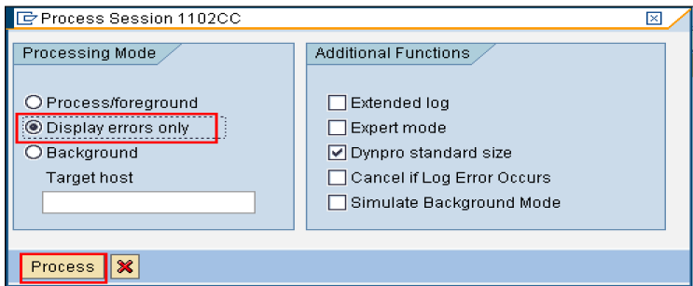
Creation of primary and secondary cost elements (Automatic Creation)
In the above window select “Display errors only” radio button and click on Process button.

Slide 10
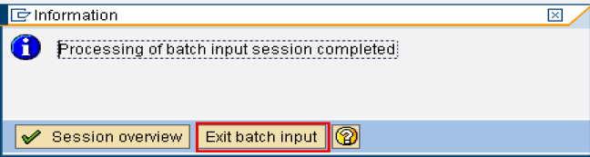
Creation of primary and secondary cost elements (Automatic Creation)
The session has been executed and below window will display here just click on “Exit Batch Input” button
By this cost elements are created automatically
NOTE: TO CREATE INDIVIDUAL PRIMARY COST ELEMENT TRANSACTION CODE IS KA01
TO CREATE INDIVIDUAL SECONDARY COST ELEMENT TRANSACTION CODE IS KA06

Slide 11
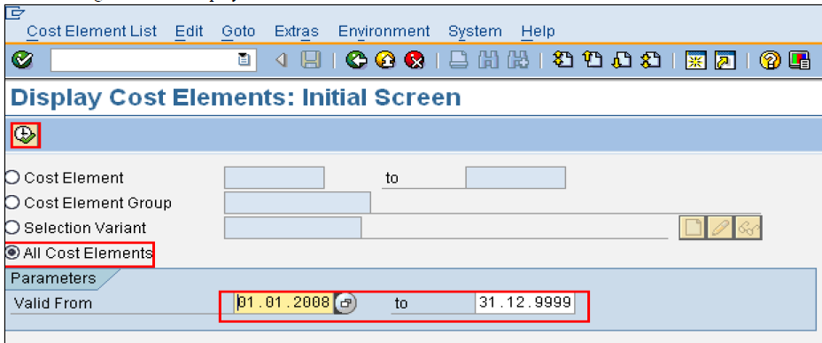
Display Cost Element Information
Path: Accounting > Controlling > Cost Element Accounting>Information System > Reports for Cost and Revenue Element Accounting (New) > Master Data Indexes > KA23 Cost Elements: Master Data Report
Transaction code: KA23

Slide 12
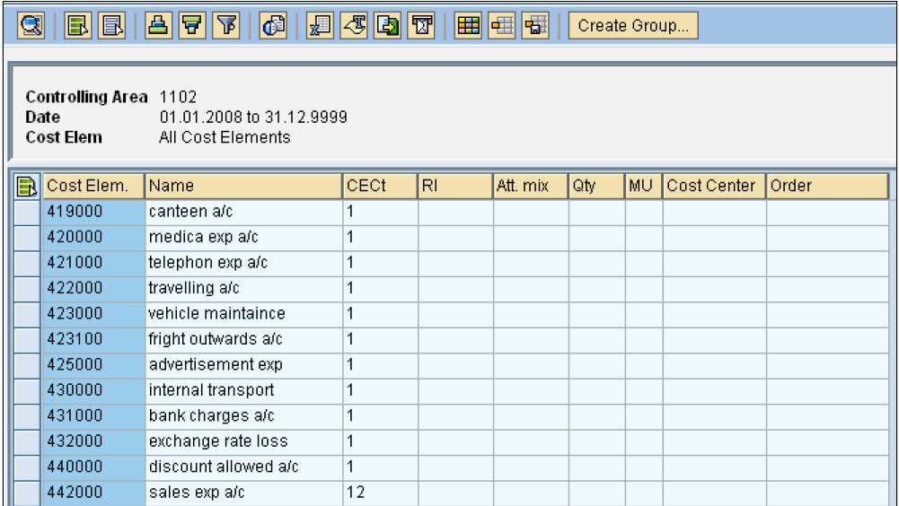
Report output

Slide 13
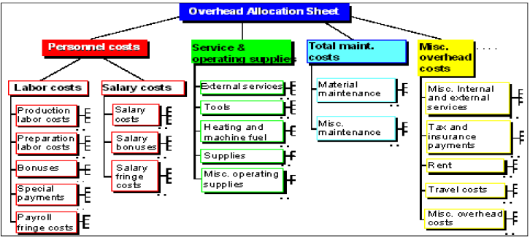
Cost Element Group
You can collect cost elements with similar characteristics in cost element groups.
The following graphic shows an example of a cost element group.

Slide 14
Cost Element Group
We can use cost element groups in the information system, for example. You can use the cost element group structure to
define the row structure of your reports. Totals are calculated in the report for each node.
we can also use cost element groups whenever you want to process several cost elements in one transaction. For example,
in cost center planning, distribution or assessment.

Slide 15

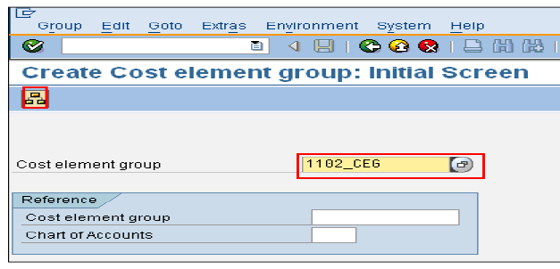
Cost Element Group Creation
Path: Accounting > Controlling > Cost Element Accounting > Master Data> Cost Element Group> KAH1-Create.
The following screen will display
Enter Cost Element Group press enter or click on Hierarchy button

Slide 16
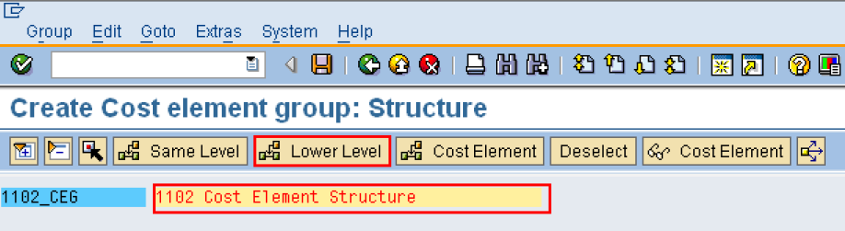
Cost Element Group Creation
It will take you to following screen
Enter the details and click on Lower level button

Slide 17
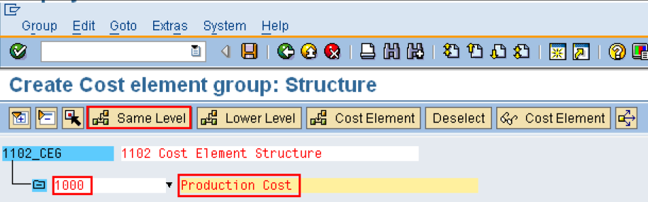
Cost Element Group Creation
it will display another level under this structure as follow:
Enter the required details.

Slide 18
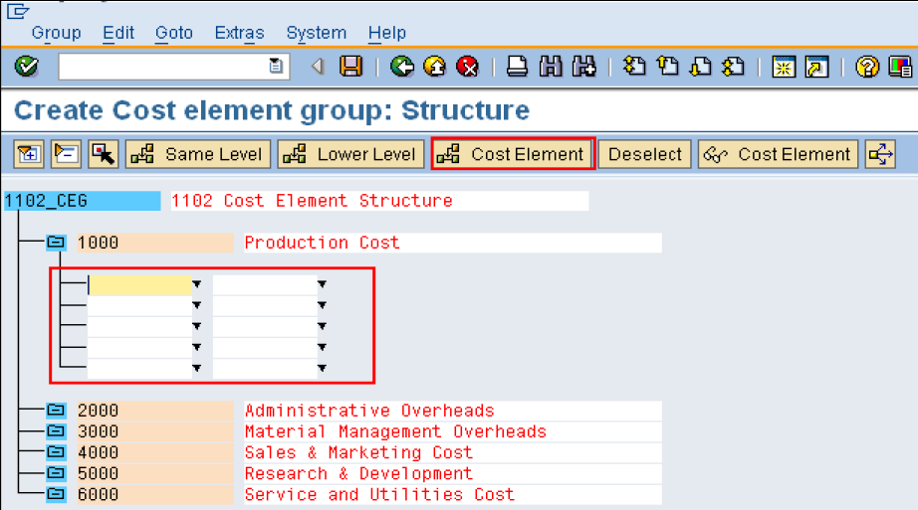
Cost Element Group Creation
To assign Cost Elements to each group place the curser on “1000” and click on “Cost Element” Button.

Slide 19
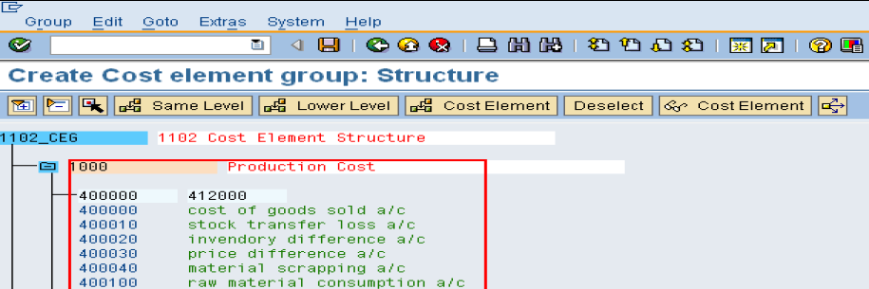
Cost Element Group Creation
Select the cost elements which needs to be assigned to the group and save.
This will complete the creation of cost element hierarchy

Slide 20
Merger of G/L Account and Cost Element
Master Data:
All Cost Elements (Incl. Secondary Cost Elements) are now G/L Accounts. Cost elements are now maintained via GL master screen.
Attribute "Account Type has been introduced in the GL master which differentiates between.
(X) B/S account, (N) Non-operating expenses and revenues.
(P) Primary costs / Revenues and (S) Secondary cost elements.
Secondary Cost elements continue to work as before (only internal postings)
Cost elements are no longer time dependent and default account assignments can no longer be maintained in the cost element master
Effects in reporting:
Secondary Cost elements now appear directly in the GL reporting. FSV must be updated accordingly (Earlier, a primary account was used for the purpose of CO/FI real time reconciliation).
Controlling module (for the moment) uses Cost Element groups.

Slide 21
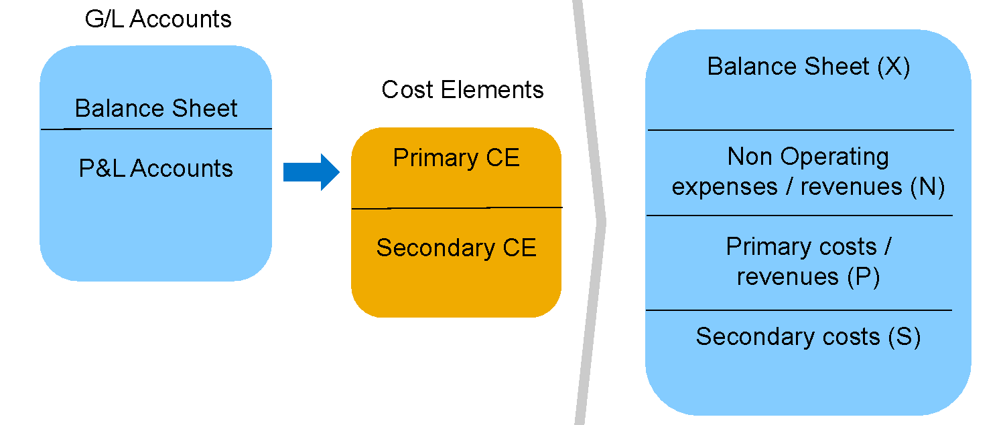
Merger of G/L Account and Cost Element (2)
Secondary Cost Elements in FSV
In earlier version of SAP, The Secondary Cost elements could not be displayed in the Financial statement. In S/4 HANA Finance, the secondary Cost elements are created as GL accounts. This gives an option of Secondary Cost elements being viewed in Financial Statement Version

Slide 22
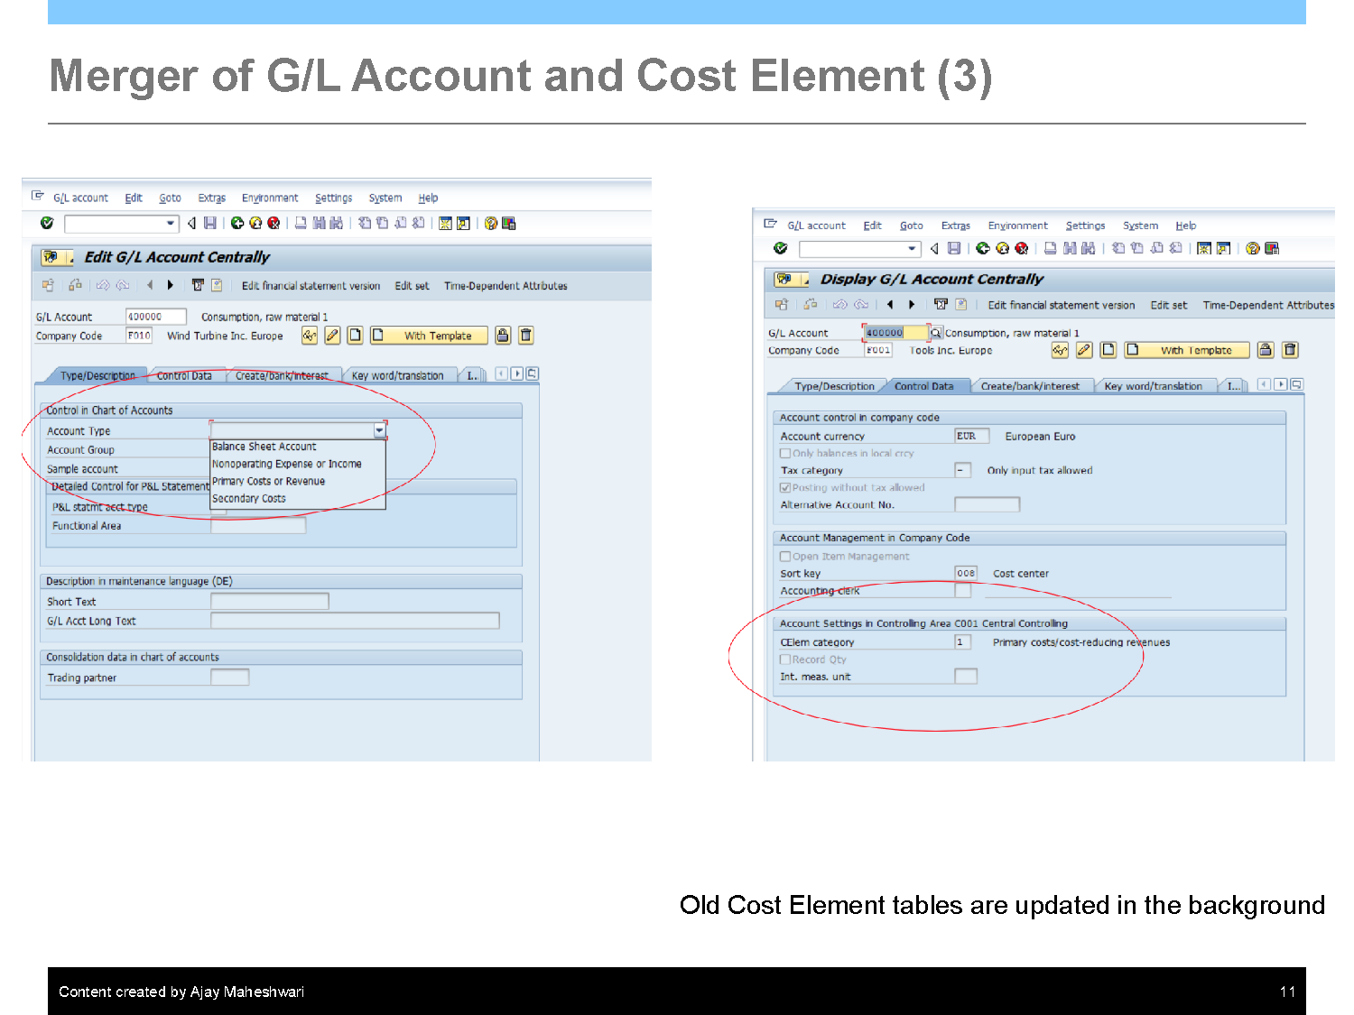
Merger of G/L Account and Cost Element (3)
Old Cost Element Tables are Updated in the background

Slide 23
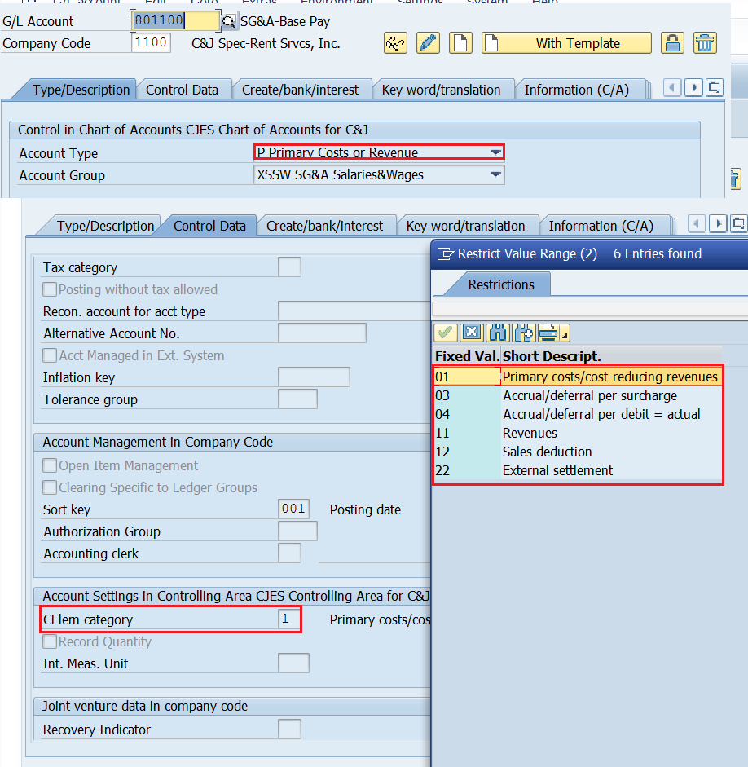
P&L Account with Cost Element

Slide 24
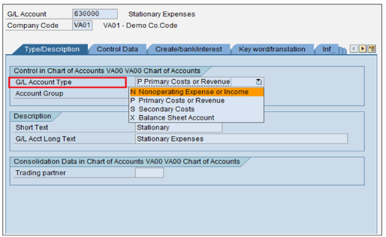
GL Account Master Record
New field ‘G/L Account Type’ is added in G/L Master data in Chart of Account Segment. The general ledger account type determines how the general ledger account can be used in financial accounting (FI) and controlling (CO).
GL Master Data can be classified under the below options:
X – Balance Sheet Account
Balance Sheet Accounts
N- Non-operating Expenses or Income
Profit & Loss account used only in FI.
P- Primary Costs or Revenue
Profit & Loss account used both in FI & CO
S- Secondary Costs
Profit & Loss account used only in CO
Notes:
The GL account master record is divided into two segments: A chart of accounts segment and a company code segment.
The chart of accounts area contains the data that is valid for all company codes, such as the account number.
The company code specific area contains data that may vary from one company code to another, such as the currency in which the account may be posted.
The result is that individual company codes can control their business processing requirements, yet the common chart of accounts provides reporting capabilities across company codes.
There are available three different transactions to create a new GL account:
FS00: centrally
FSP0: in chart of accounts (only)
FSS0: in company code

Slide 25
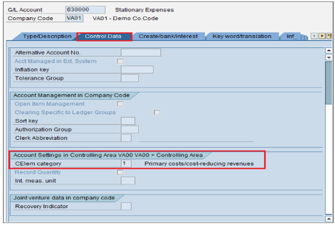
More Information On General Ledger Master Data
New Field ‘Cost Element Category’ under Control Data updates account settings for the Controlling Area.
The following cost element categories are available when G/L account type P – Primary Cost or Revenue is selected.
1 | Primary costs/cost-reducing revenues
3 | Accrual/deferral per surcharge
4 | Accrual/deferral per debit = actual
11 | Revenues
12 | Sales deduction
22 | External settlement

Slide 26
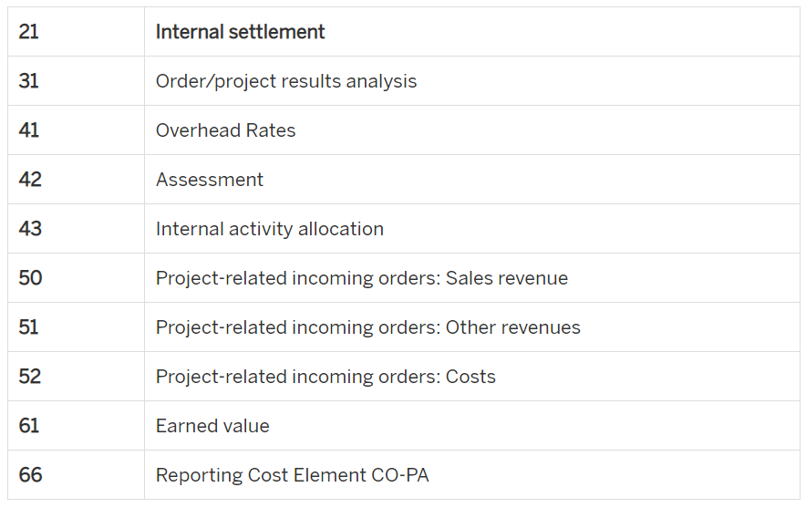
The following cost element categories are available when G/L account type S – Secondary Costs is selected.

Slide 27
Cost Center Accounting
You use Cost Center Accounting for controlling purposes within your organization. The costs incurred by your organization should be transparent. This enables you to check the profitability of individual functional areas and provide decision-making data for management. This requires that all costs be assigned according to their source. However, source-related assignment is especially difficult for overhead costs. Cost Center Accounting lets you analyze the overhead costs according to where they were incurred with in the organization.
Depending on the level of decision-making powers assigned to the manager of an organizational unit, you can distinguish between various types of responsibility areas within an organization:
Cost center | Recording costs with reference to plan values
Profit centers | Calculating operating results
Investment centers | Calculating Return On Investment In the SAP system you can create an investment center in the Profit Center Accounting component (EC-PCA). You do this by assigning balance sheet items to a profit center.

Slide 28
Features:
Entering actual costs: Primary costs can be transferred to Cost Accounting from other components, for example, Materials Management (MM), Asset Accounting (AA), Payroll Accounting (PY). Additional costs and outlay costs are recorded using the accrual method.
Allocating actual costs: You can use various methods to further allocate the actual costs you have recorded, according to their source. The system distinguishes between transaction-based allocations, which occur within one period, and period based allocations, which occur at period end.
Planning activities and costs: You can use planning to define organizational targets and carry out regular cost effectiveness checks. Variances can be calculated by comparing the actual costs and activities with the plan values. These variances serve as a control signal, which helps you to correct business processes, when required. You can plan costs and activities to determine allocation (activity) prices.
Allocating plan costs: All actual allocations that occur for cost centers can also be planned (for example, distribution, assessment, indirect activity allocation).
Entering plan and actual statistical key figures: Statistical key figures are used as the basis for the indirect allocation methods, as well as for evaluations in the information system (for example, employees, telephones).
Activity Accounting: Activity Accounting uses the activity produced by a cost center as the tracing factor for the costs. You can use activities to measure the operating rate or the rate of capacity utilization for a cost center. The target costs of the cost center refer to the activity output. Depending on the source of the costs, the activities of a cost center are divided into various activity types (for example, for the Work center cost center: Repair hours or Assembly hours.)
Information system: The information system provides tools with which you can analyze the cost flows that have occurred in your organization. You can carry out standard recurring evaluations; and create special reports for unique tasks or situations.

Slide 29
Cost Center Categories
To classify and specify the types of cost center and to control the data flow to the cost centers by cost center
category you can maintain the following types of data to cost centers:
Planed Primary cost
Planed Secondary Cost
Planed Revenues
Actual Primary Cost
Actual Secondary Cost
Actual revenue
Commitment Items
Functional Area in Formation
Quantitative Information

Slide 30

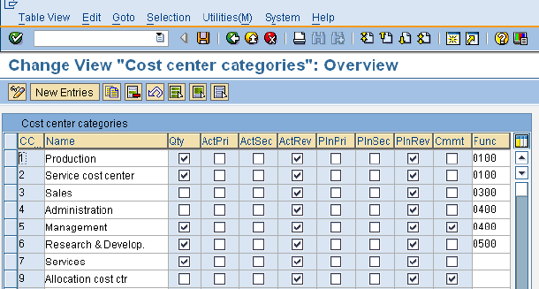
Define Cost Center Categories
Path: SPRO-> Controlling-> Cost Center Accounting-> Master Data-> Cost Centers-> Define Cost Center Categories
Transaction code: OKA2
SAP provided all types of Cost Centers Categories as we shown below. If you want to create any new click on and specify Cost Center Category (CCTC), name and all other parameters and save.

Slide 31
Cost Center Group
You can collect cost centers according to various criteria into groups. This enables you to use cost centers to depict the structure of the organization in the SAP System.
You can use the groups to build cost center hierarchies, which summarize the decision-making, responsibility, and control areas according to the particular requirements of the organization. The individual cost centers form the lowest hierarchical level.
There must be at least one group that contains all cost centers and represents the entire business organization. This cost center group is described as the standard hierarchy. You can assign more cost center groups to the standard hierarchy.
You can also create any number of alternative groups. You can structure these, for example, according to organizational and/or functional viewpoints. Cost center groups enable you to perform evaluations for each decision-making, responsibility, or control area. They also support the processes during planning and internal allocations.
You can assign each cost center to only one group in the standard hierarchy, but to as many alternative groups as you require.

Slide 32

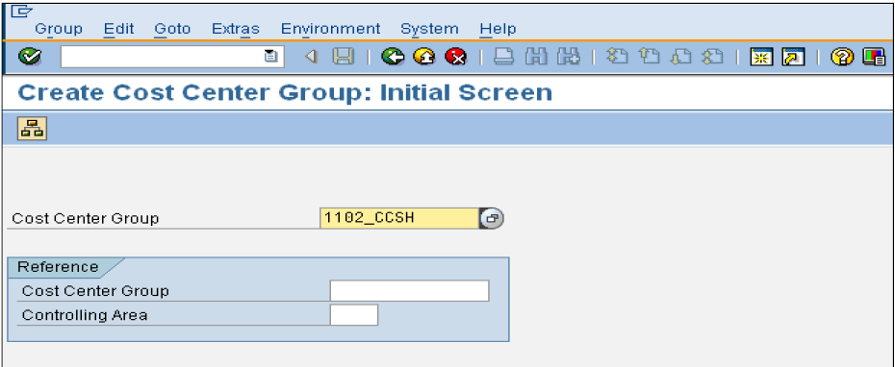
Creation of Cost Center Group
Path: Accounting-> Controlling-> Cost Center Accounting-> Master Data-> Cost Center Group-> KSH1 – Create
Transaction Code: KSH1
In above screen Cost Center Group name will display automatically and just click on Hierarchy button

Slide 33
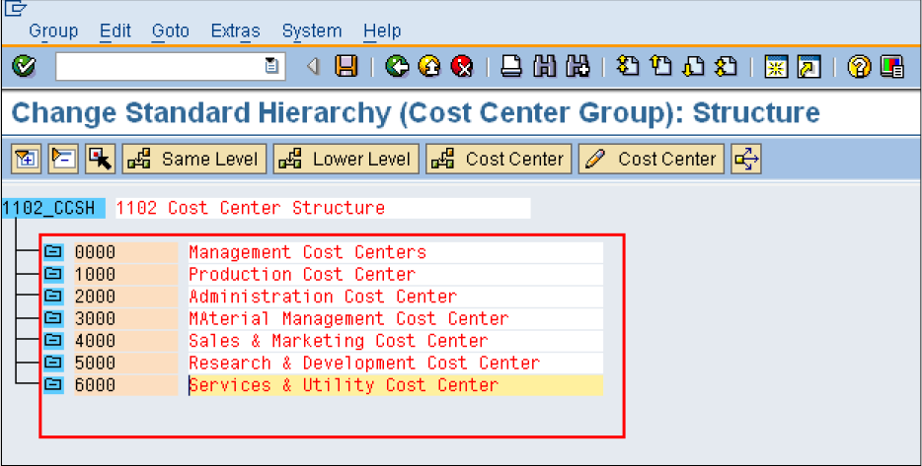
Creation of Cost Center Group
In the below screen type the description and place the curser on the same window and click on Lower Level button
It will display Lower Level Group. Enter the details of the groups that needs to be created.
In case if you want to create a group in the same level. Click same level button.

Slide 34
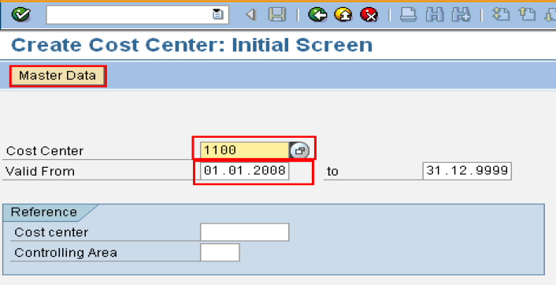
Creation of Cost Centers
Path: Accounting-> Controlling-> Cost Center Accounting-> Master Data-> Cost Center-> Individual Processing ->KS01 – Create
Transaction Code: KS01
In the below window enter the details:
Cost Center number
Valid From
To
Enter above parameters and click on save button to save the activity.

Slide 35
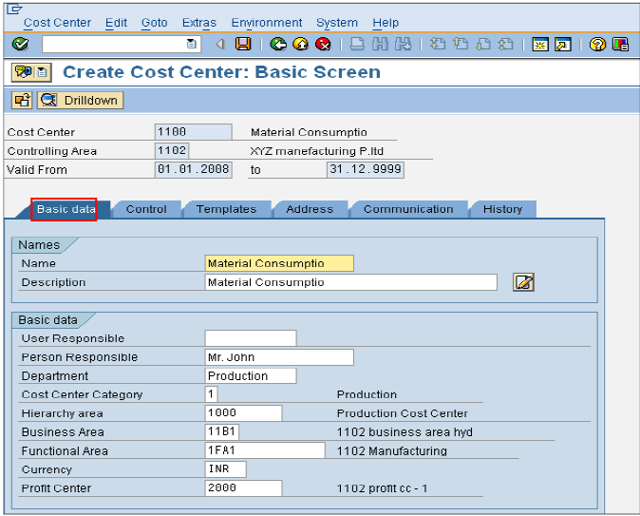
Creation of Cost Centers
Immediately after you click on save button it will save and take you to previous screen. So you can change the Cost Center number and create another one.

Slide 36
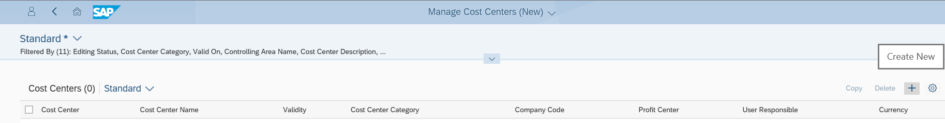
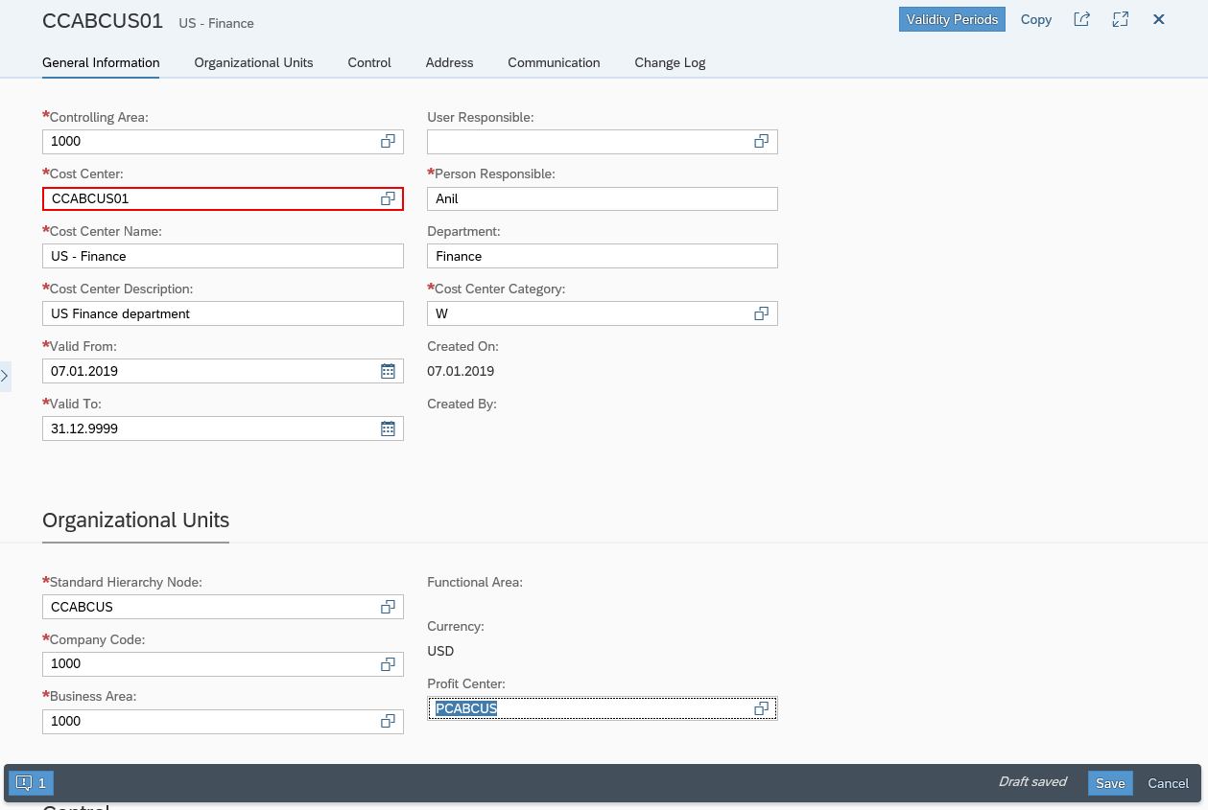
Cost Center – Master Data
1.Click on create new (+) and It takes you to below input screen
Step 2: Enter Controlling area
Step 3: Enter new Cost Center Code
2
Step 4:Enter Name of the Cost Center
3
7
Step 5: Enter description for this Cost Center
4
8
Step 6: Enter Validity start and End date
5
9
Step 7: Enter Person responsible for Cost Center
6
Step 8: Enter responsible department
Step 9: Select Cost Center Category
Step 10: Select Cost Center Hierarchy
10
Step 11: Select Company code
11
Step 12: Select Business area
12
13
Step 13: Select Profit Center

Slide 37
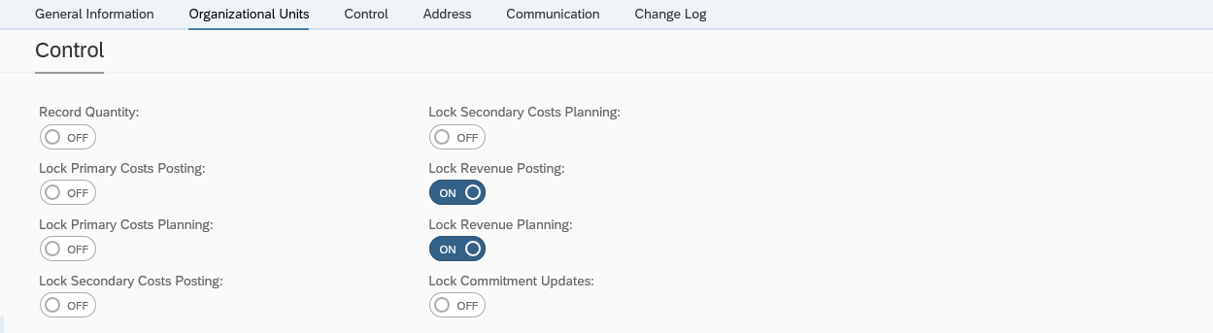
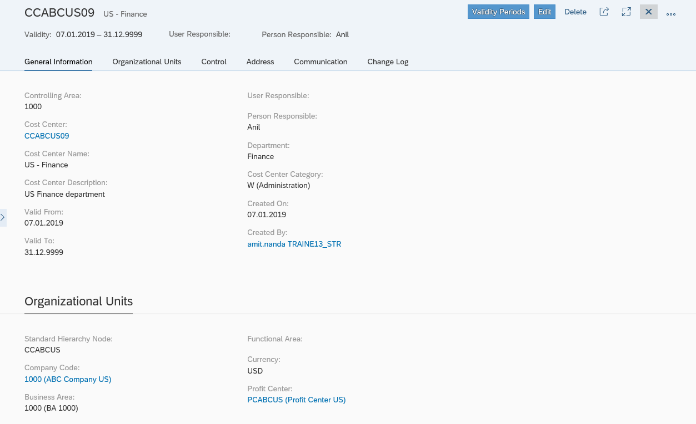
Cost Center – Master Data
Step 14: Choose Cost center relevancy for Qty, Cost element Planning & Posting
14
Step 15: Click on save
Fiori Output screen

Slide 38
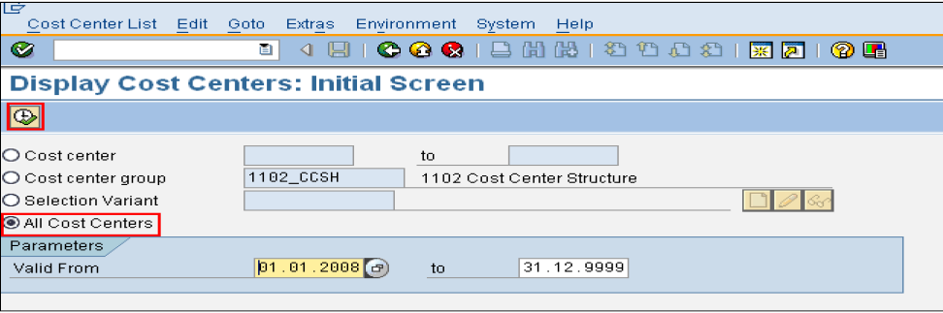
To print Cost Center Information
Path: Accounting-> Controlling-> Cost Center Accounting-> Information System -> Reports for Cost Center Accounting -> Master Data Indexes-> KS13 - Cost Centers: Master Data Report
Select “All Cost Centers” and click on button

Slide 39
Internal Orders
Internal order is a method to collect those costs and business transactions related to the task/activity
It is a means of tracking costs of a specific job, service, or task . Periodically the costs which are pooled in an internal order can be settled to an asset or to a cost center or to a GL Account or to an order. Thus, while recording you need not analyze the costs. Just record and pool the costs in internal order. After that (generally at the end of the month) these costs are analyzed and settled to relevant elements (like asset or cost center etc.)
This method of recording and settling the costs helps in analyzing the costs cost center wise, profit center wise or cost element wise. This level of monitoring can be very detailed but allows management the ability to review Internal Order activity for better-decision making purposes
Internal Orders are used for short term purpose like Trade Fairs, Job Fairs etc., where as Cost Centers are used for long term purpose to capture the day to day costs

Slide 40
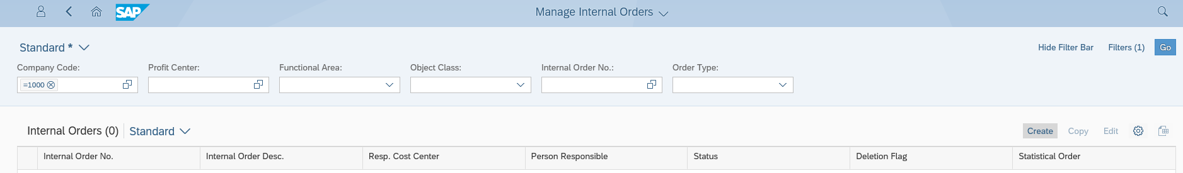
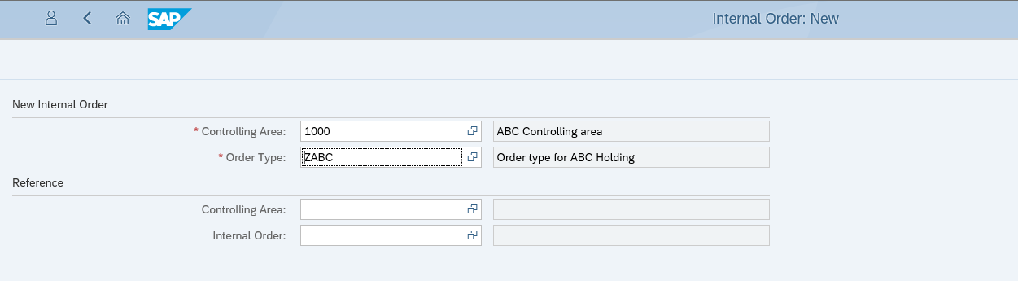
Internal Order
1.Click on “Create”
2. Enter Controlling area
3. Enter Order type
4. Press “Continue”

Slide 41
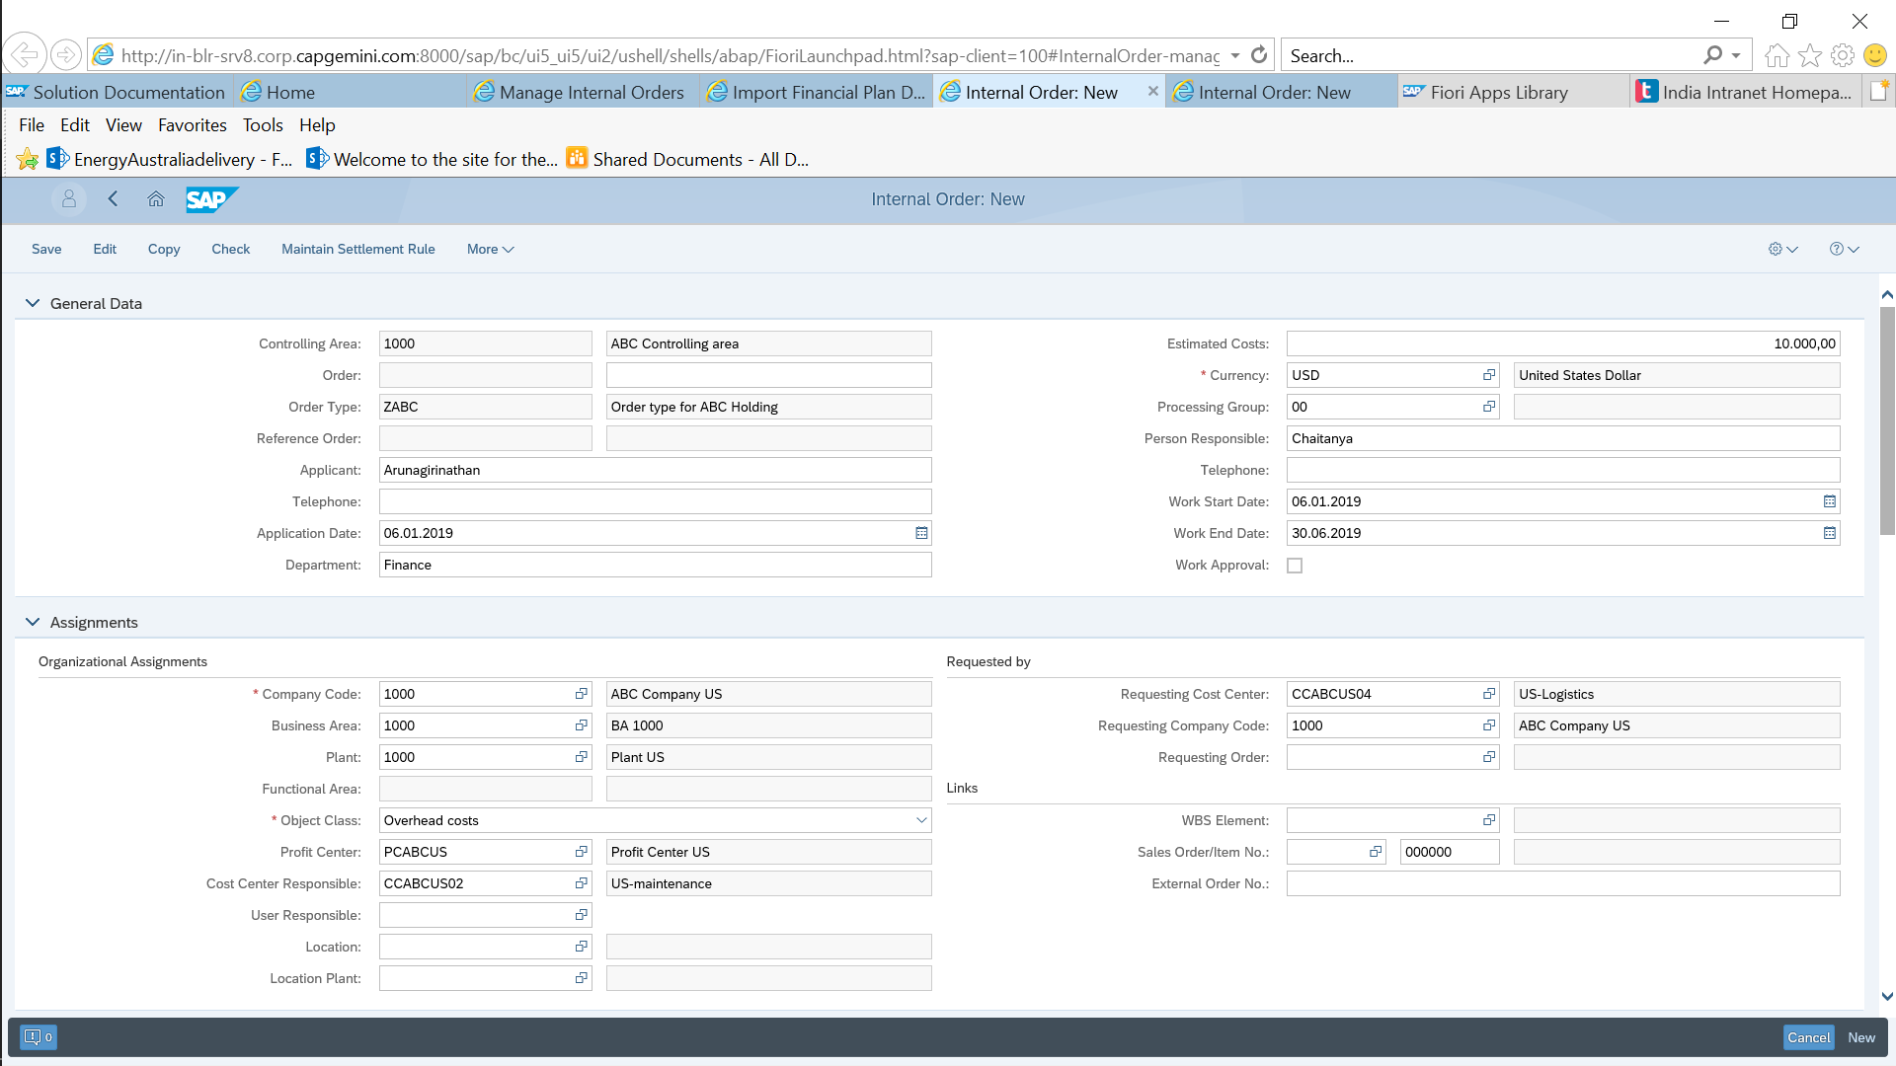
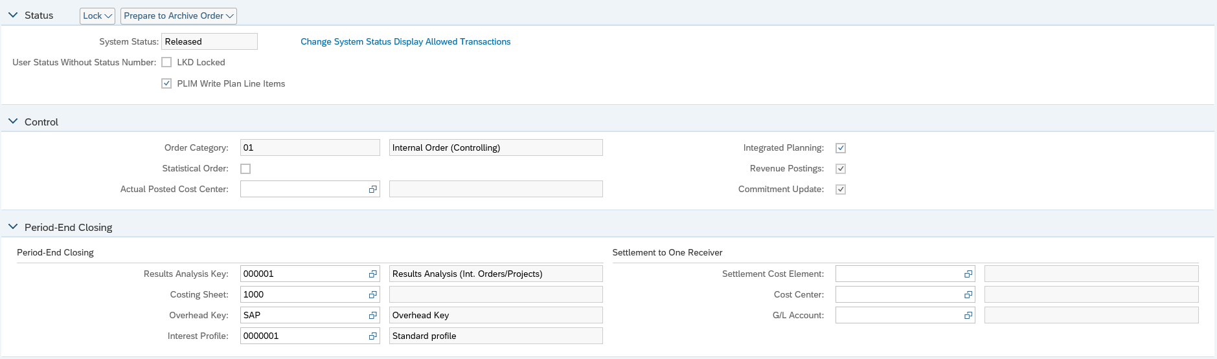

Internal Order
8. Enter Estimated cost
24.Click on ’Save’
9. Enter Currency
5. Enter Applicant name
10. Enter Person responsible
11. Enter Start date
6. Enter Application date
12. Enter End date
7. Enter Department
18. Enter Requesting Cost center
13. Enter Company code
14. Enter Business Area
19. Enter Requesting Company Code
15. Enter Plant
16. Enter Profit center
17. Enter Cost center
25. Order Creation confirmation message
20. Enter Result analysis key
21. Enter Costing sheet
22. Enter Overhead key
23. Enter Interest Profile

